Slide 1

EE 463 Hardware Project
2022-2023 Fall
Four-Quadrant DC Motor Driver Using an H-Bridge and a Chopper
with Closed-Loop Current Control
Hard-Time Regulators
İsmail Macit - 2305084
Fatih Erden - 2304566
Işık Emir Altunkol - 2442408
December 12, 2022

Slide 2
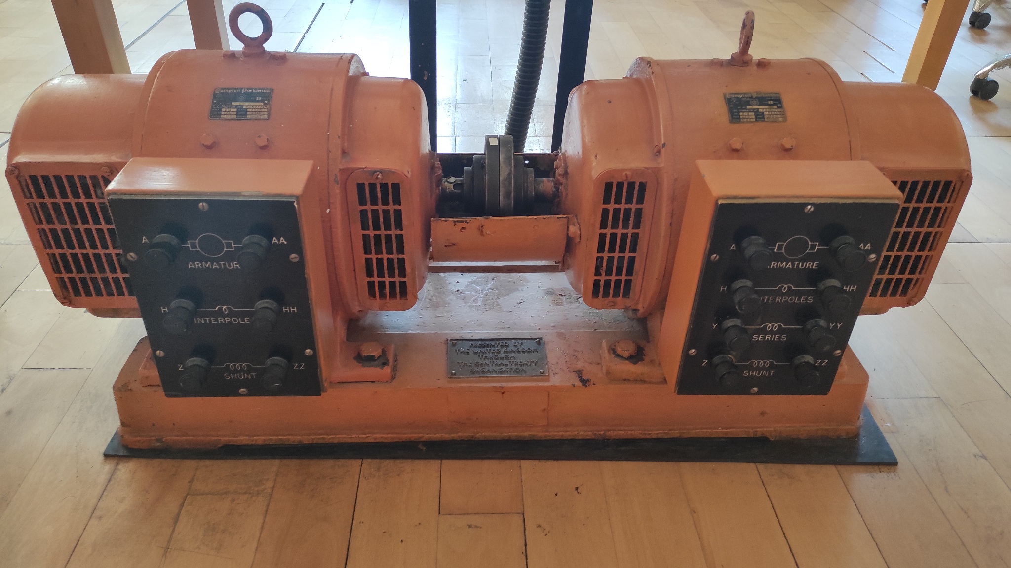
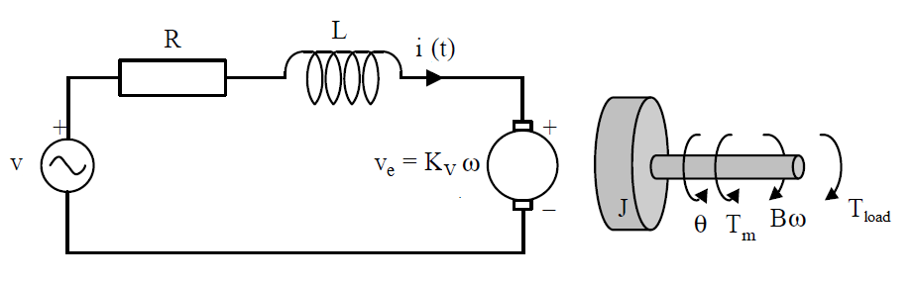
Introduction: DC Motors

Slide 3
Introduction: Motor Drives
Large current requirements
Precise control ability
Voltage/Current protection

Slide 4
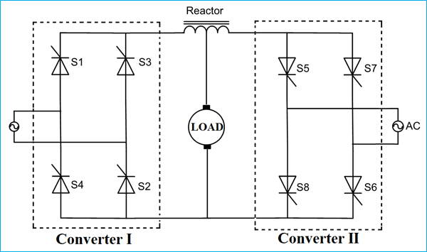
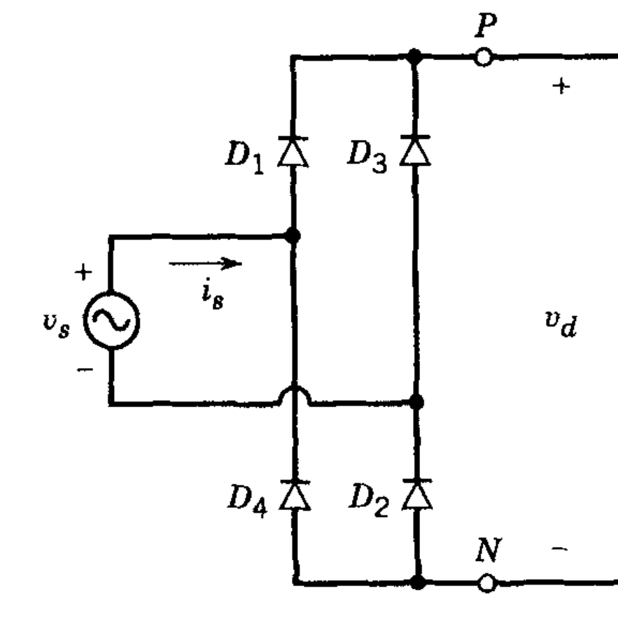
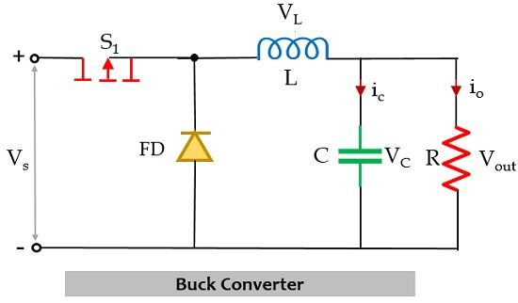
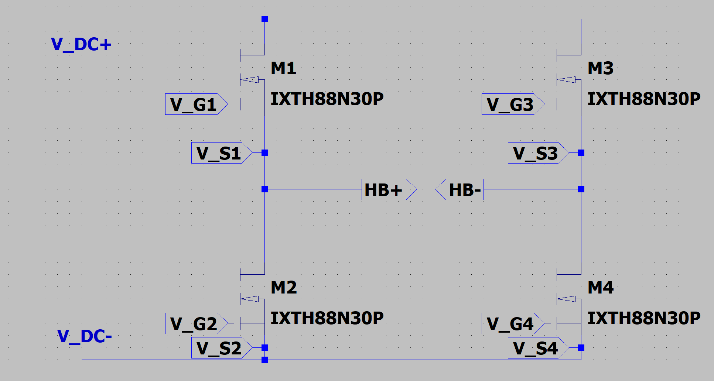
Design Decisions: Topology Selection
Notes:
Many designs exist, most simple one is 1 phase fbdr, but not for four quadrant
H bridge is one option
thyristor dual converter is second option
bu we have chosen h bridge with a chopper as the final choice, and to reduce the ripple we will use 3 phase fbdr

Slide 5
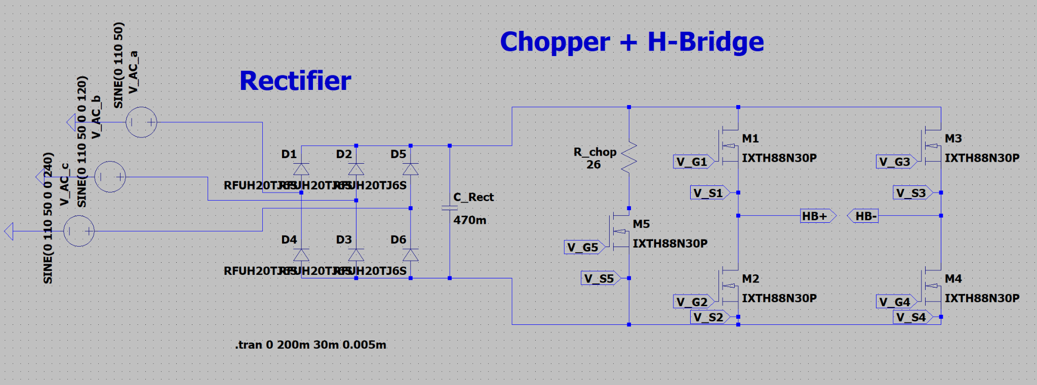
Design Decisions: Topology Selection

Slide 6
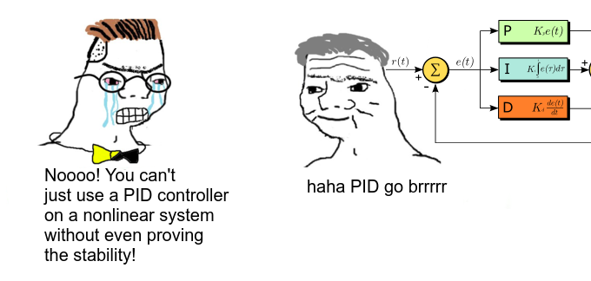
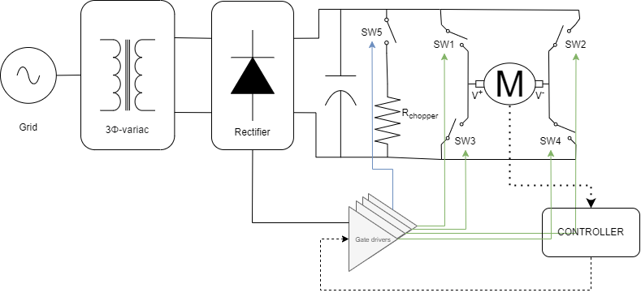
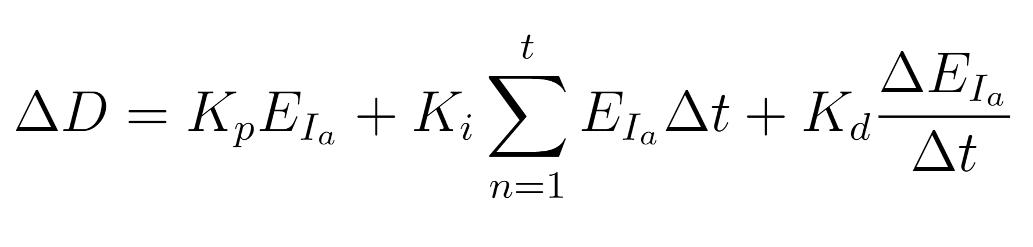
Design Decisions: Control Methodology
Notes:
Off the shelf half bridge gate drivers
Microcontroller - arduino
PWM duty will be adjusted for different mosfets for different modes
Closed loop PID current control will be implemented to reduce the ripple and avoid high currents and voltages
Duty change will be adjusted
Tuning will be done after the test setup is ready, possibly with potentiometers

Slide 7
Design Decisions: PCB Implementation
Smaller and compact
Easier to assemble and manufacture
Resilient to external factors such as vibration
More control over the electrical design
- Better noise immunity and EMC
- Increased efficiency
Notes:
The advantages of pcb implementation

Slide 8
Design Decisions: Other Considerations
Mechanical design: A suitable case with labels on required measurement and input-output ports will be designed.
Single supply: The design is aimed to be powered by only a three phase AC supply. Commercial converters which are used for home appliance applications will be investigated.
Notes:
All the internal power conversions will be handled
All

Slide 9
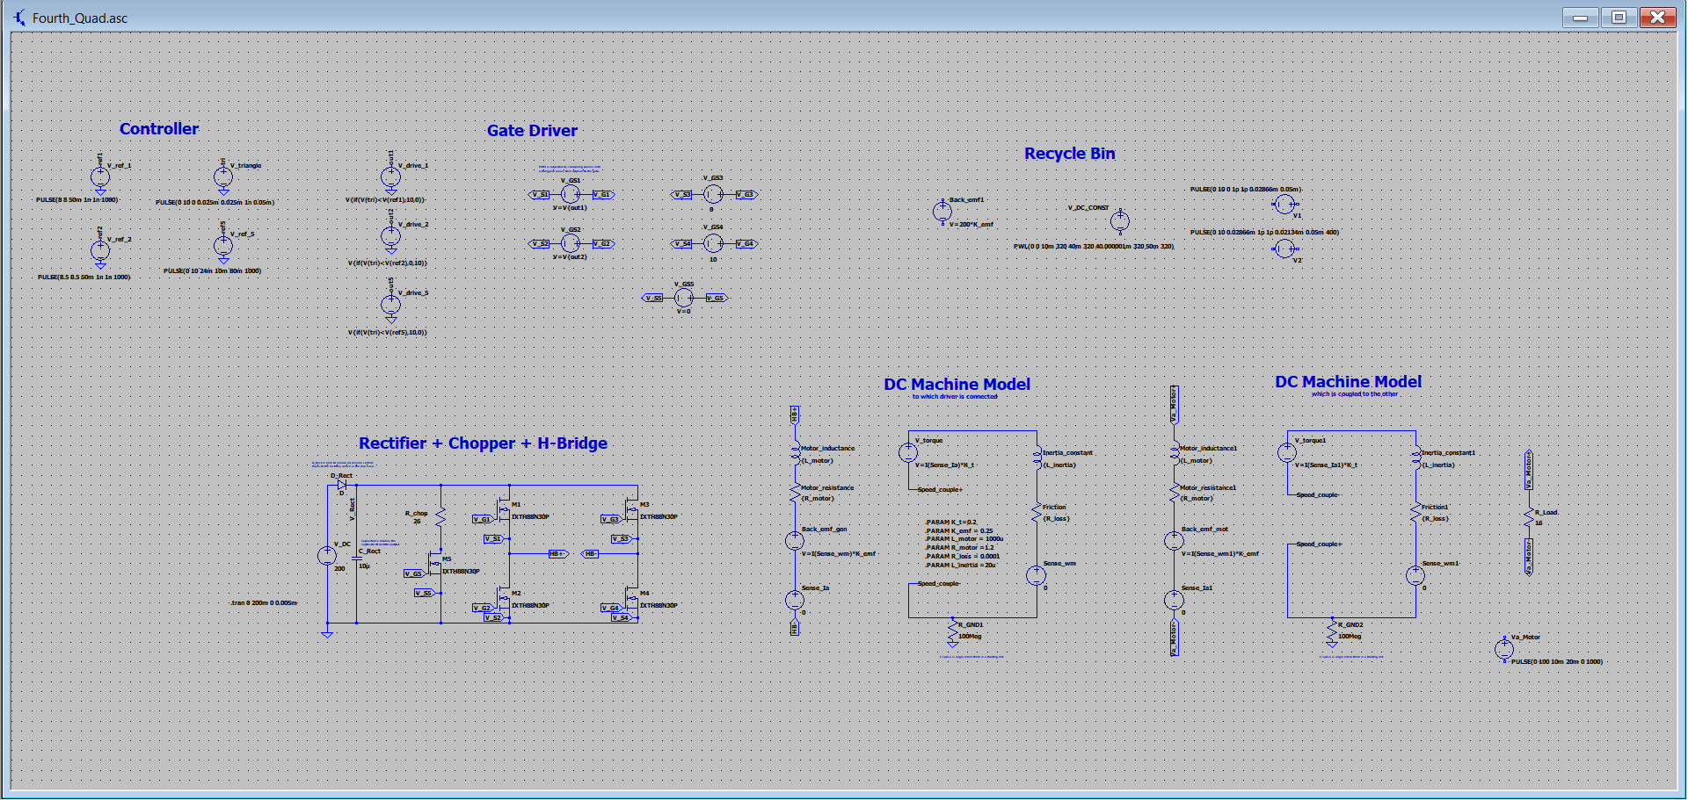
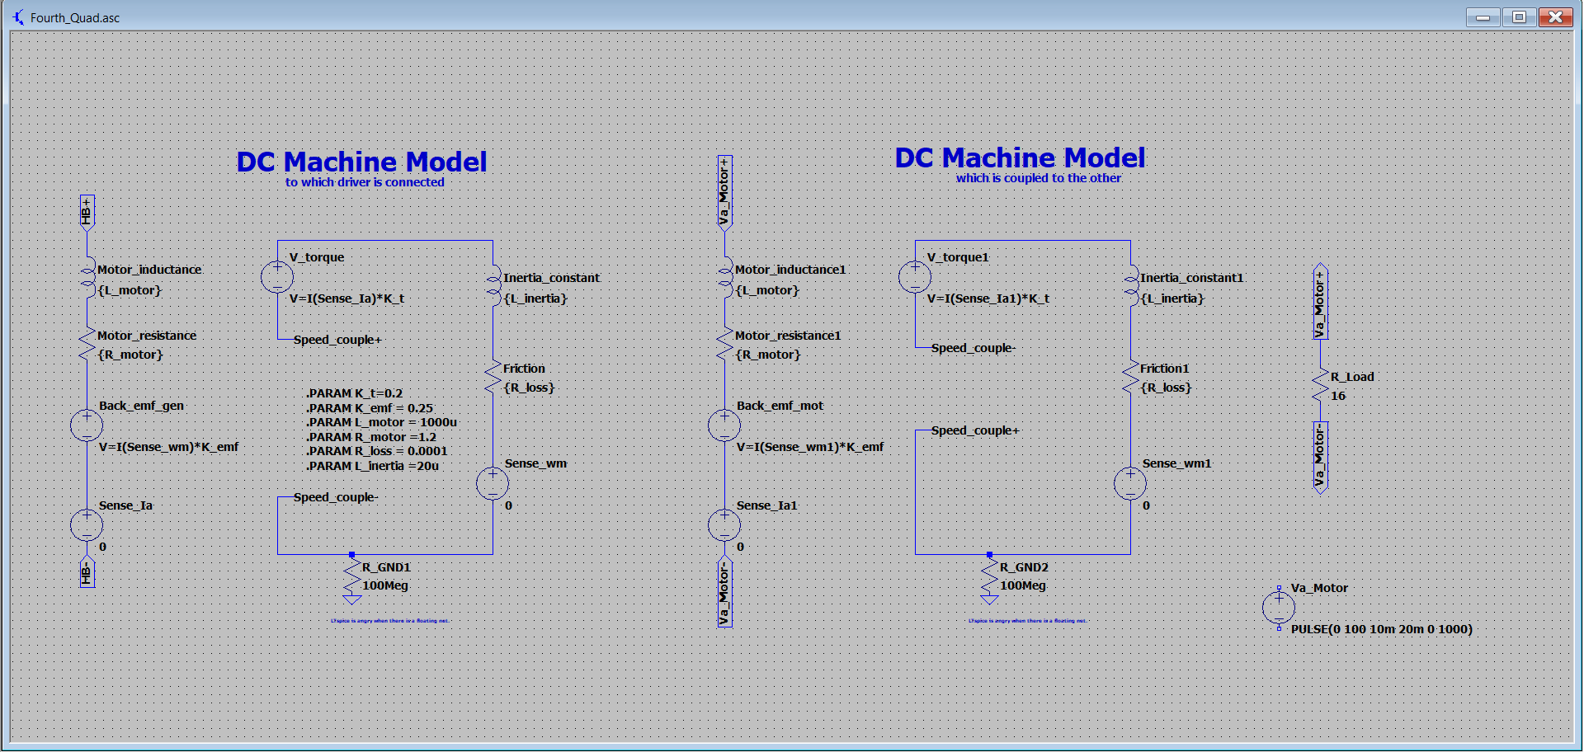
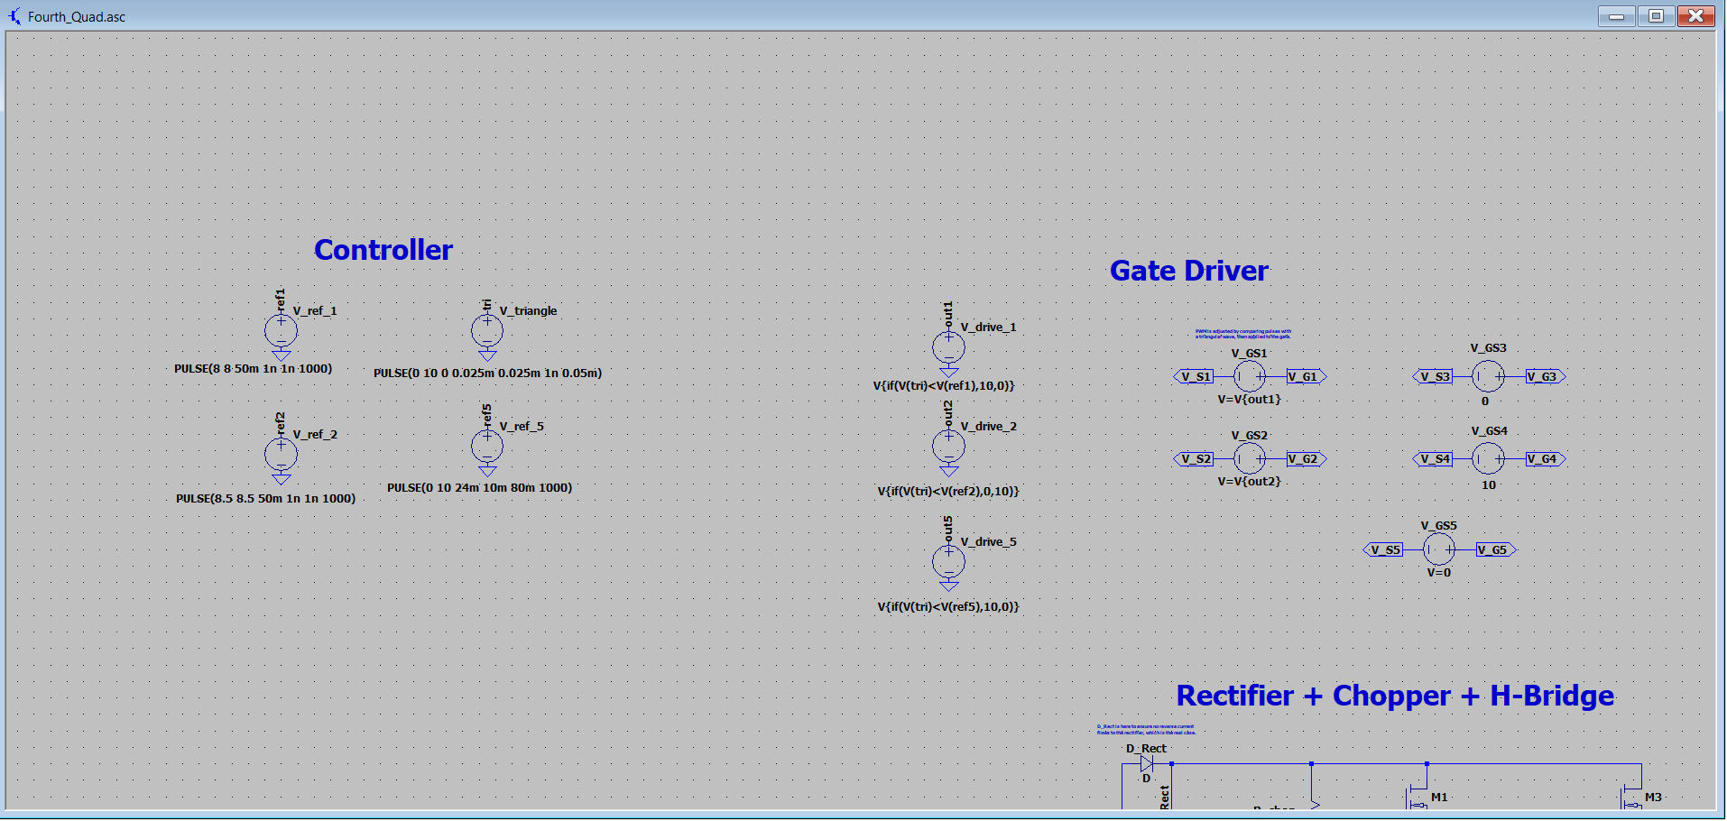
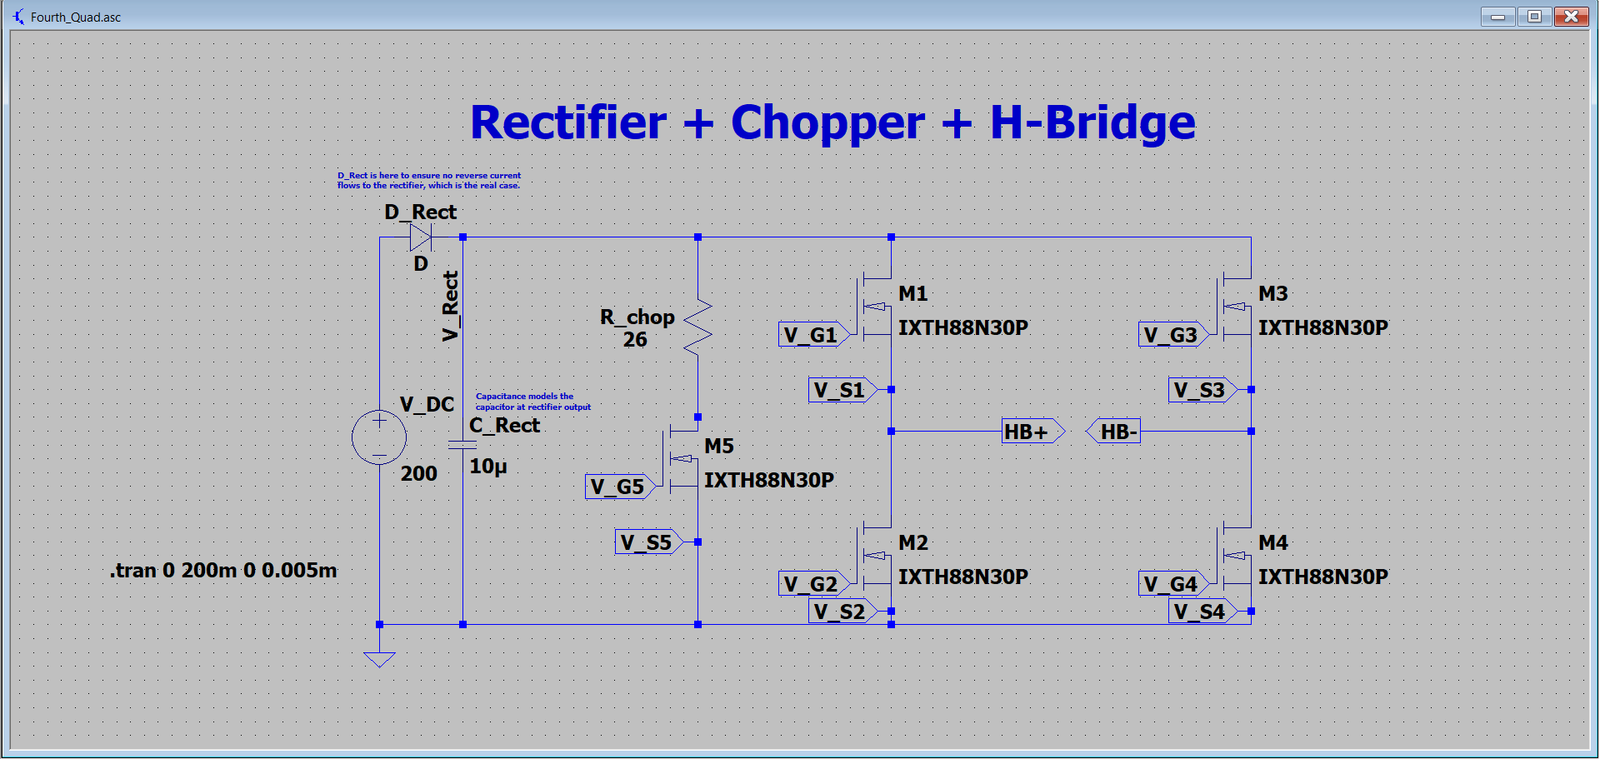
Simulations: The Models
Notes:
All the internal power conversions will be handled
All

Slide 10
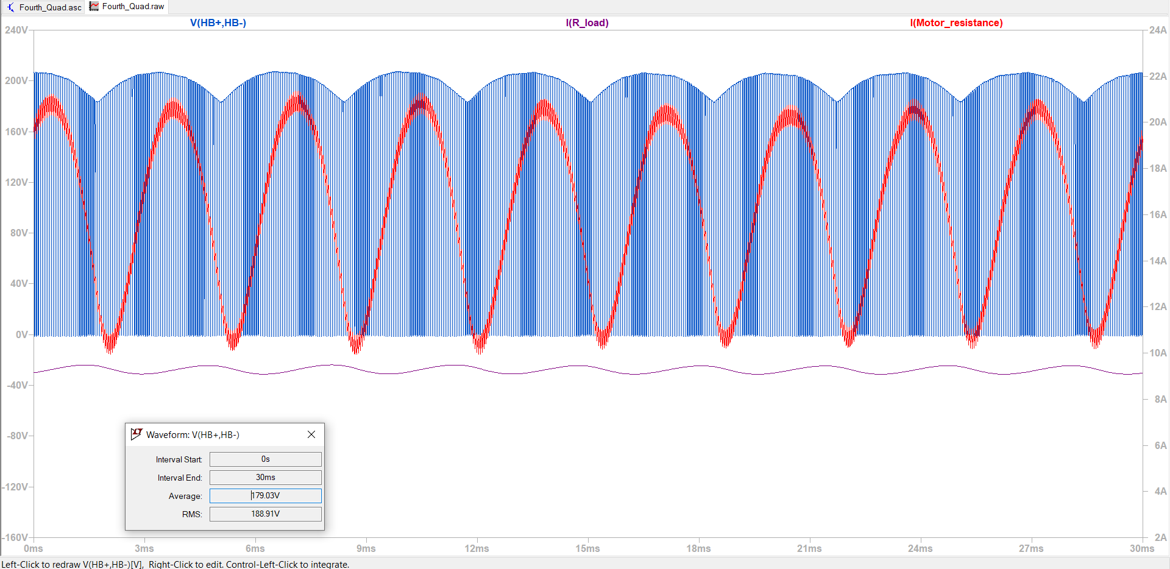
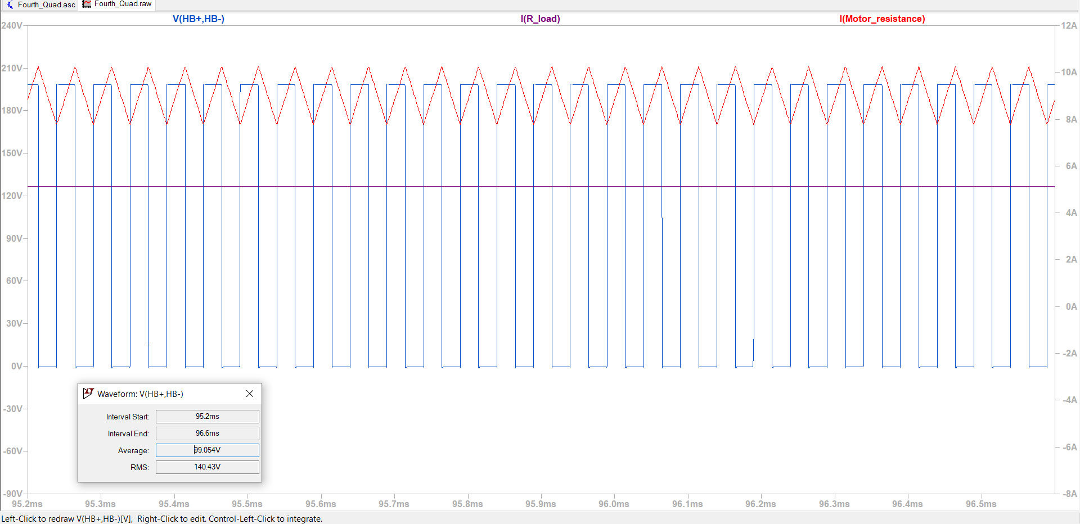
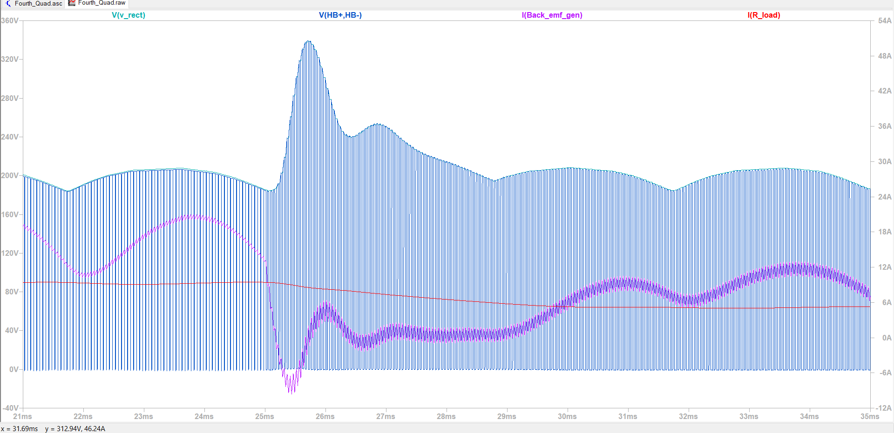
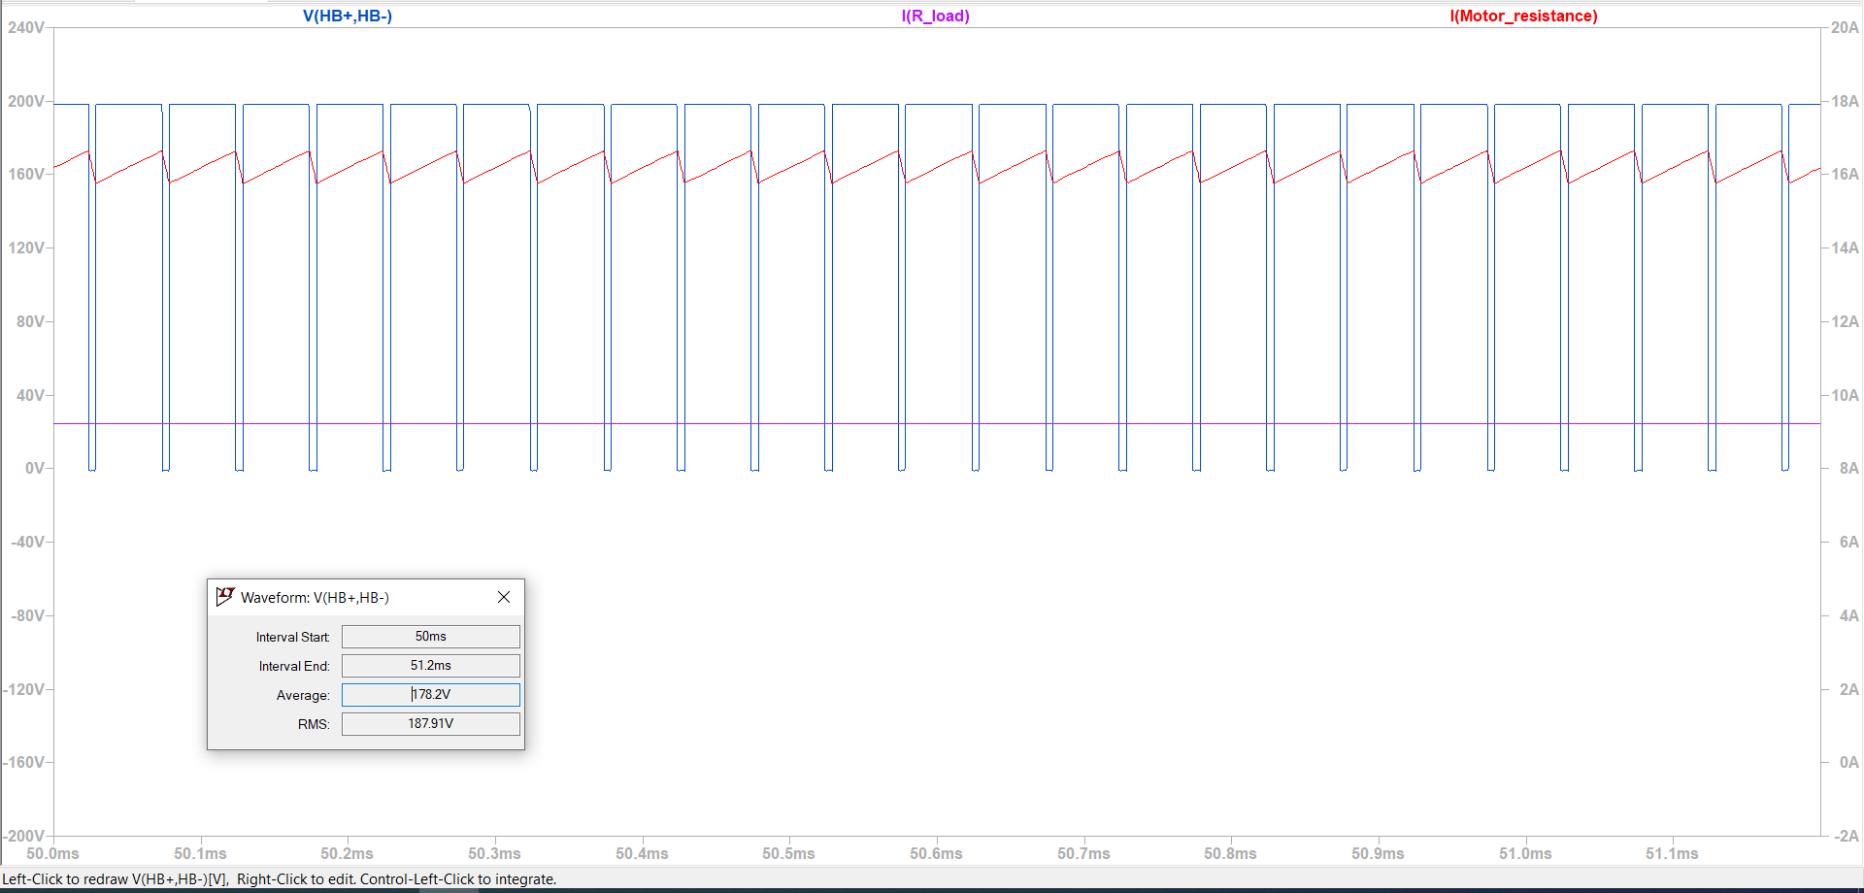
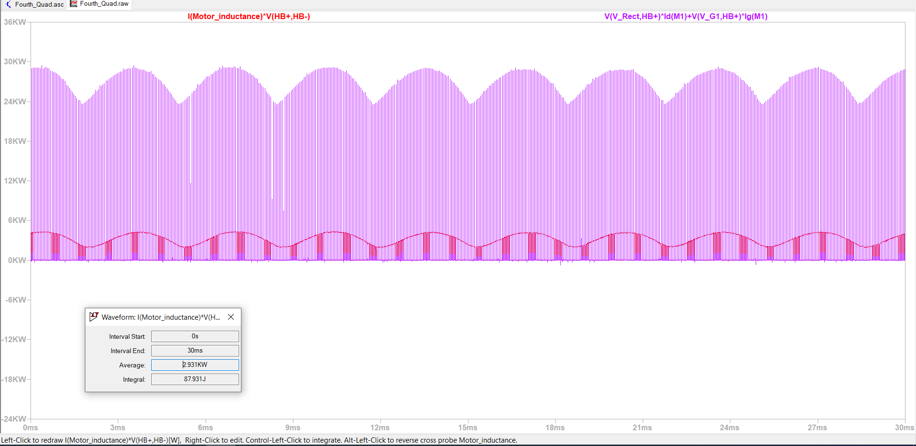
Simulations: Forward Motoring
(Synchronous Buck)
Regenerative Breaking!
Notes:
All the internal power conversions will be handled
All

Slide 11
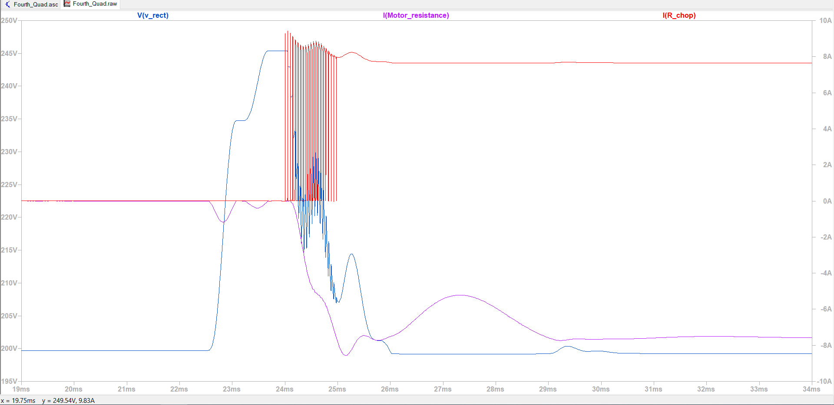
Simulations: Continuous Generation
Notes:
All the internal power conversions will be handled
All

Slide 12
Simulations: Other quadrants are the same!
Notes:
All the internal power conversions will be handled
All

Slide 13
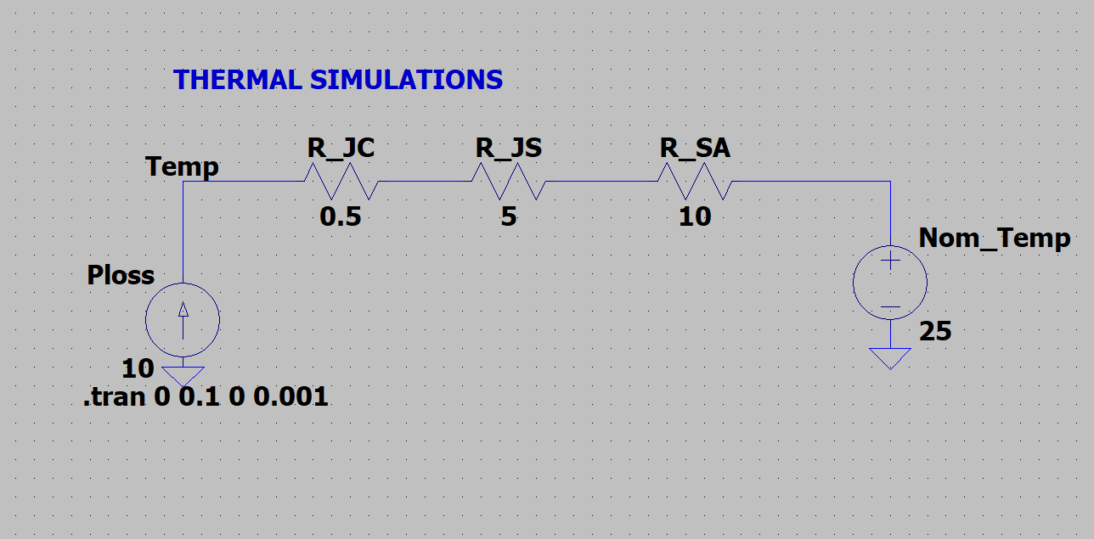
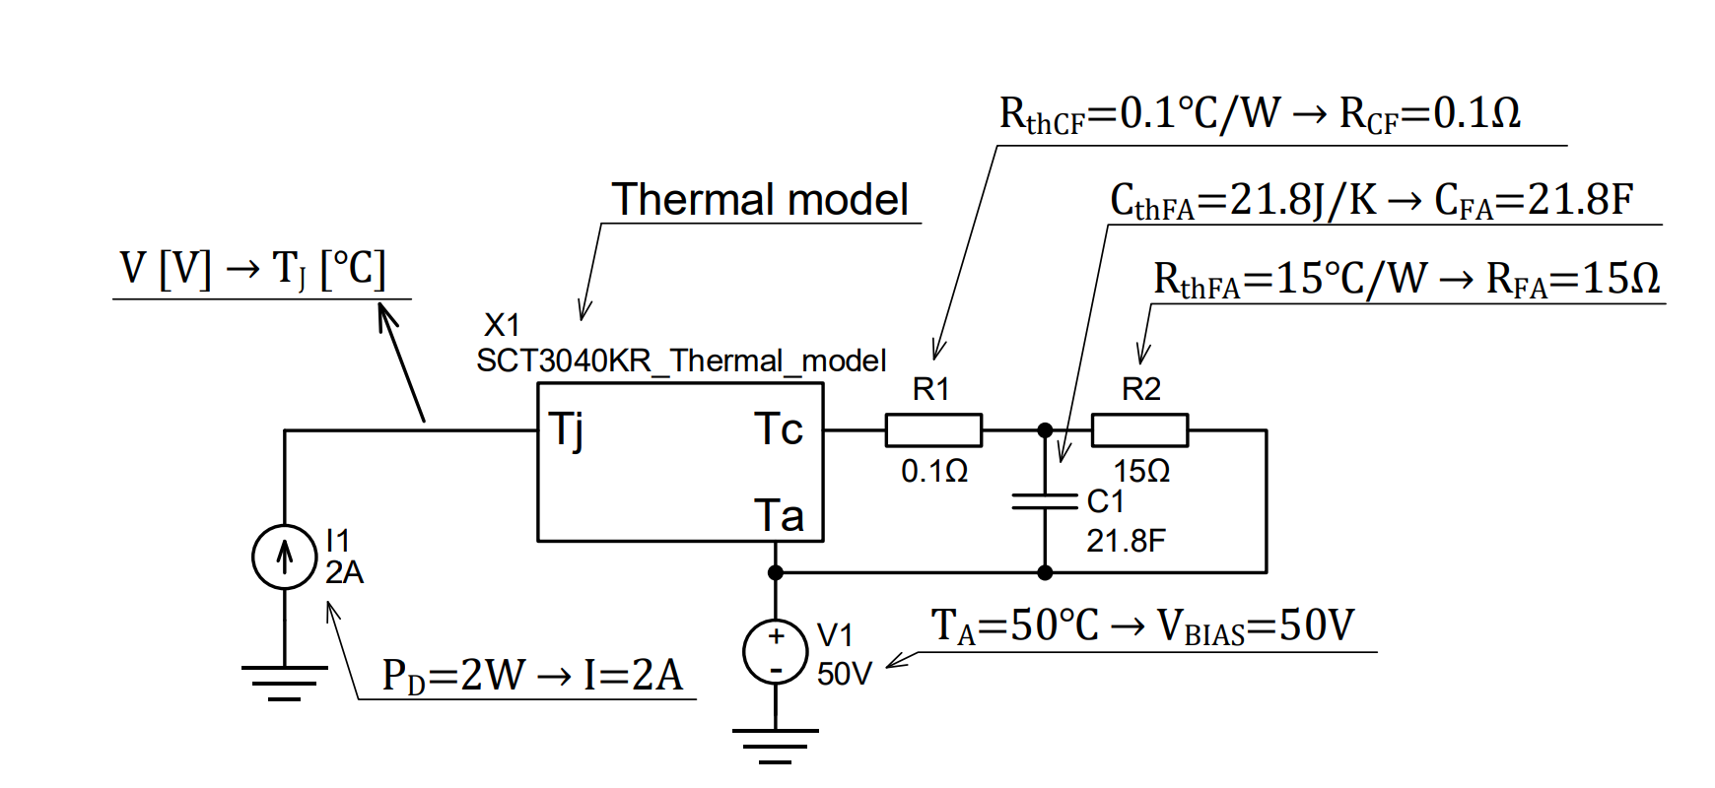
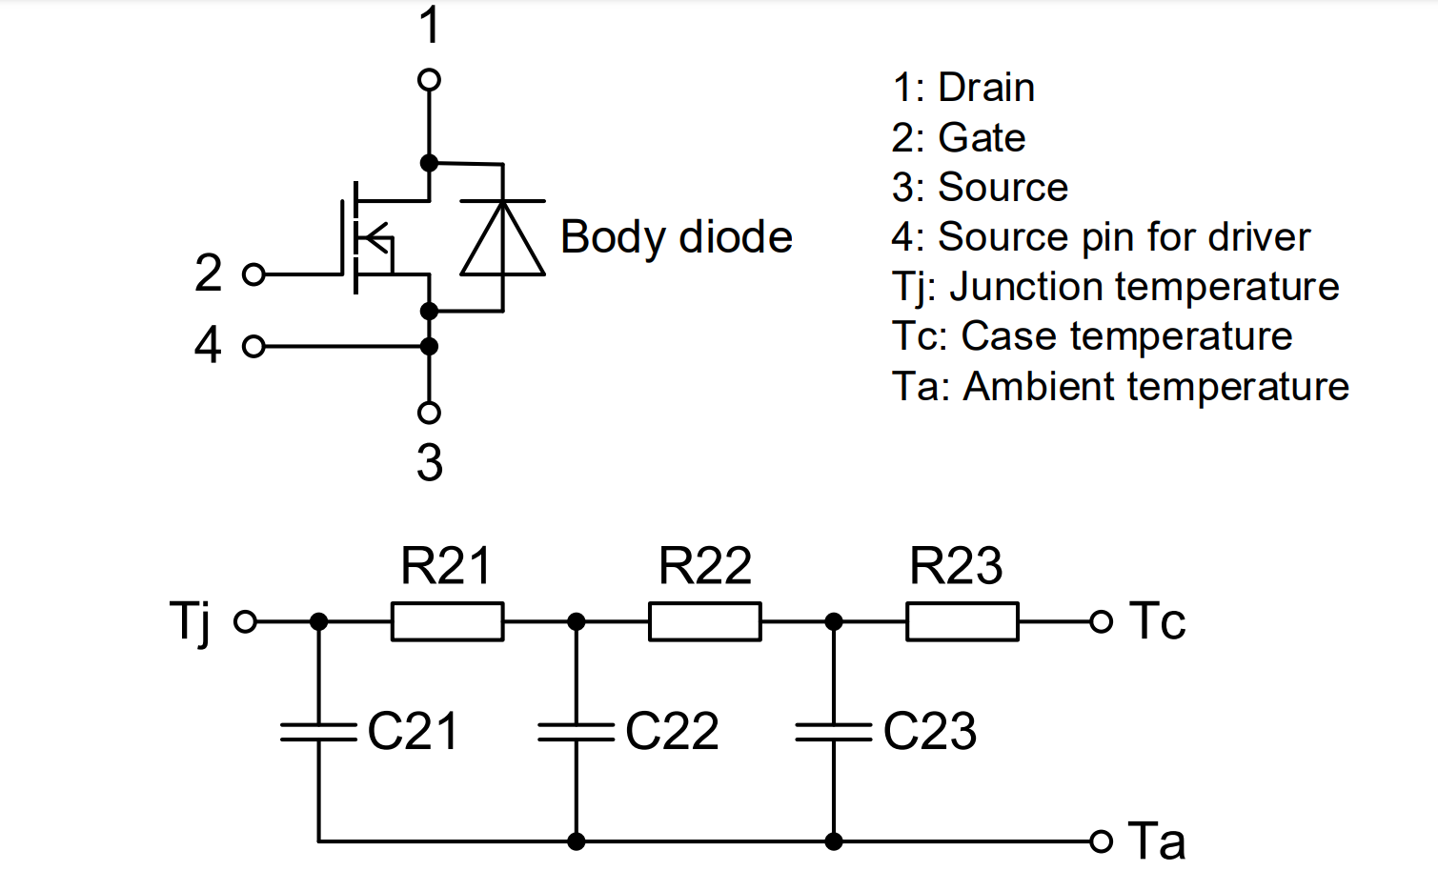
Thermal Considerations
Specifications and Requirements
Thermal limits are important
More complex models!
Notes:
More complex simulations and calculations will be made
Heatsink and fan will be utilized

Slide 14
Component Selection:
Specifications and Requirements
For MOSFETs:
Higher breakdown voltage, higher current rating → Higher cost
Higher current rating → Lower conduction resistance → Higher efficiency
Higher breakdown voltage → Easier design, possibly less linear region losses → Higher efficiency and safety
Higher efficiency + Easier design + Lesser risk → Higher cost
Engineering → Optimize these according to the needs
Notes:
Rds on (hence conduction losses) is inversely proportional with the current rating, which brings a price tradeoff
Lower voltage ratings require more careful designs to avoid voltage spikes, good avalanche ratings, and careful control; possibly lots of gate opening losses to stay in the linear region more to avoid the spikes, which is a large trade-off and risk

Slide 15
Component Selection:
Specifications and Requirements
Several options for MOSFETs:
MODEL | Vds Voltage (V) | Continuous Id Current (A) | Rds_on (mOhm) | Price ($)
IRFP254B | 250 | 25 | 140 | 0.61
IXTP36N30P | 300 | 36 | 110 | 4.97
IXFP38N30X3 | 300 | 38 | 50 | 6.13
Similar comparisons are done/will be done for the other components
Notes:
Here we can see the trade offs between the MOSFET choices

Slide 16
References
[1] https://fscdn.rohm.com/en/products/databook/applinote/discrete/sic/common/how_to_use_thermal_models_an-e.pdf

Slide 17
Thank you for your attention.

